Slide 1
NETWORK PROVIDER DATABASE MANAGEMENT SYSTEM
TEAM MEMBERS | NU ID
SRUTHI BHASKAR | 002791003
NIHARIKA VITTAL | 001523748
SOUMYA RAYAPPANOR | 002747973
Project Demo
December 10, 2022

Slide 2
ER Diagram

Slide 3
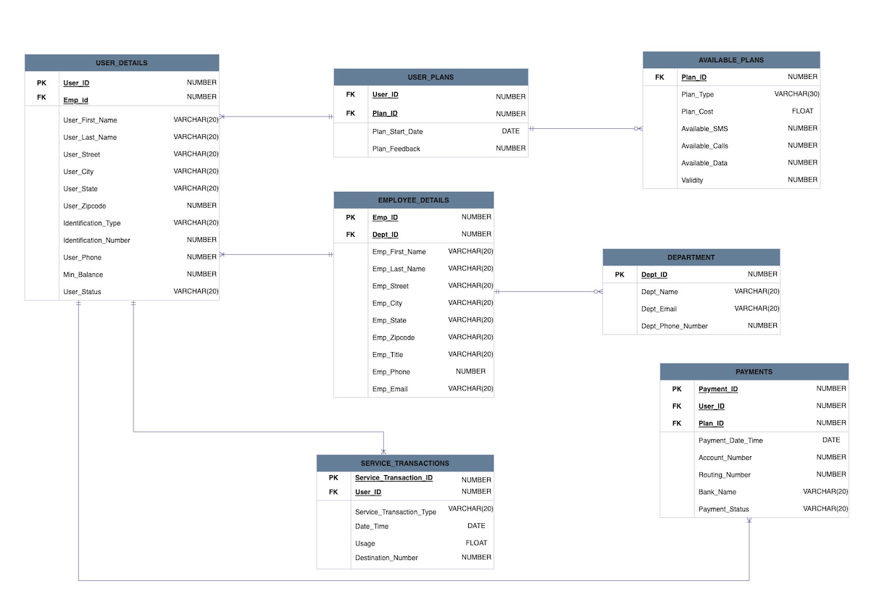

Slide 4
System Functionalities

Slide 5
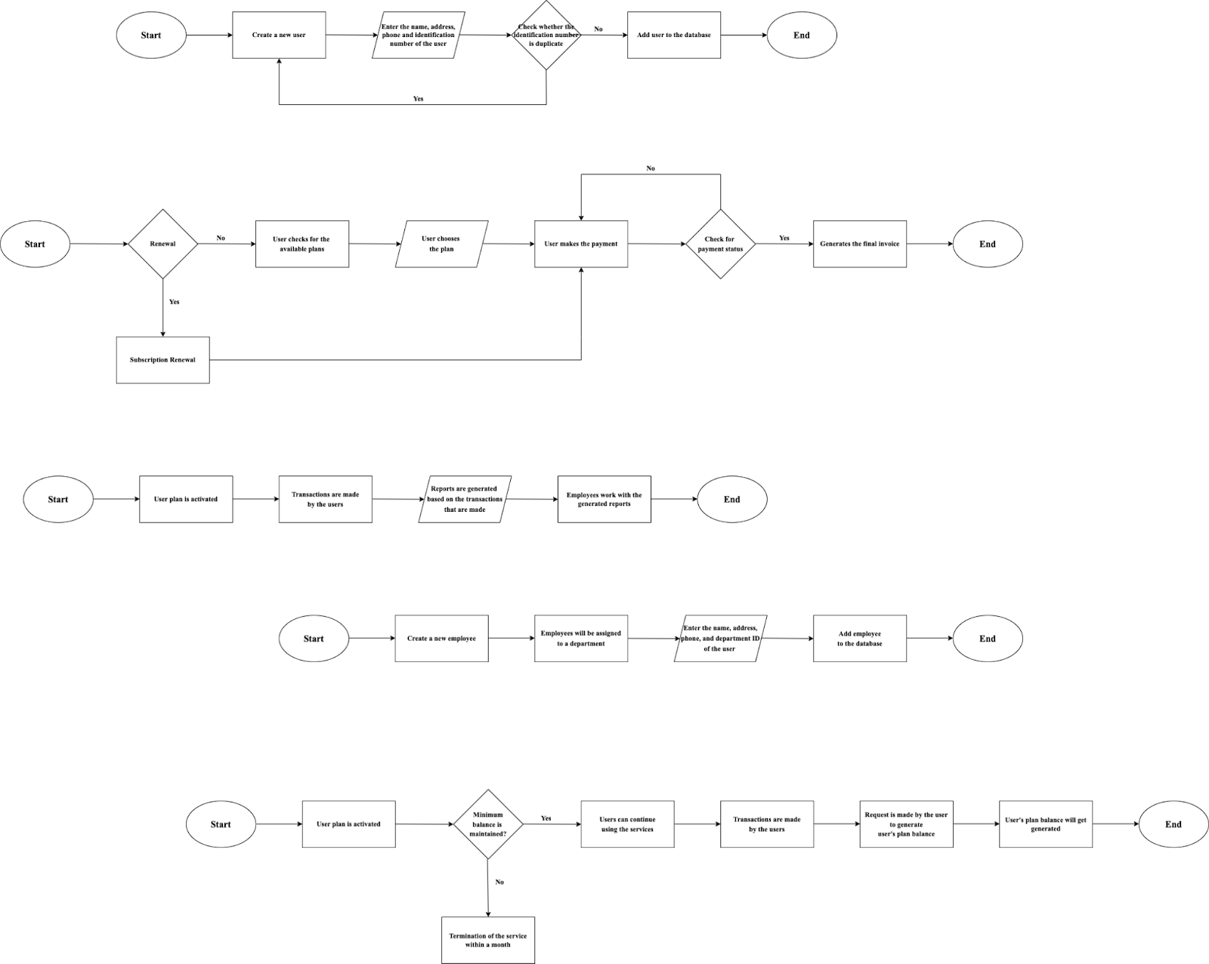
USER Module
EMPLOYEE Module

Slide 6
PLANS and PAYMENT Module
User’s Balance Module

Slide 7
Deliverables

Slide 8
Tables

Slide 9
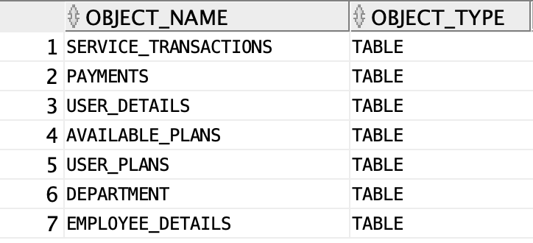

Slide 10
Views

Slide 11
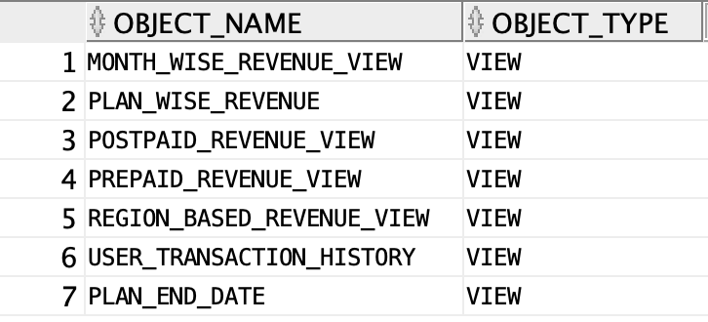

Slide 12
Indexes

Slide 13
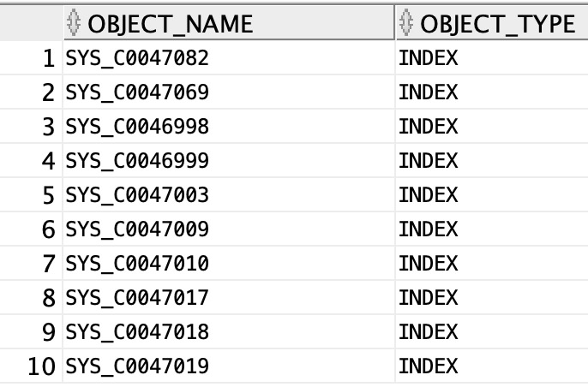

Slide 14
Triggers

Slide 15
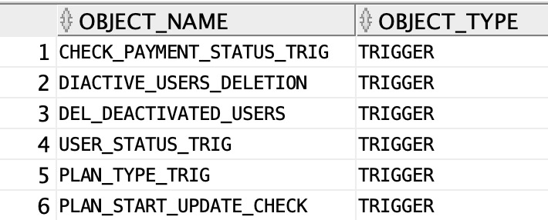

Slide 16
Stored Procedures, Functions, Packages & Sequences

Slide 17
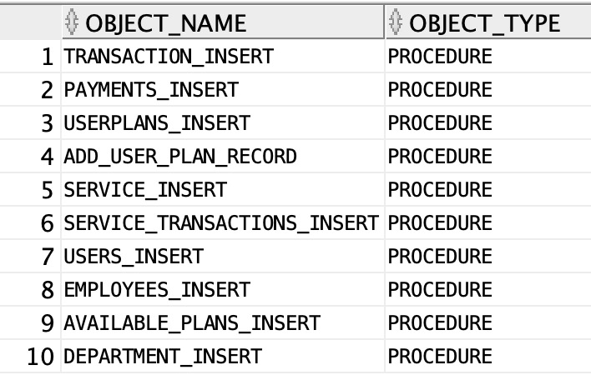
STORED PROCEDURES

Slide 18
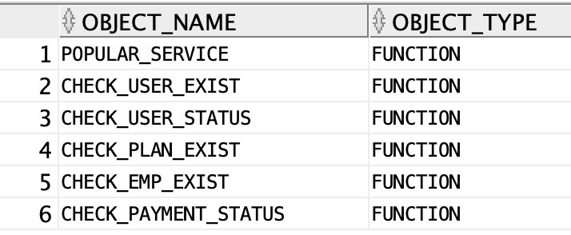
FUNCTIONS

Slide 19
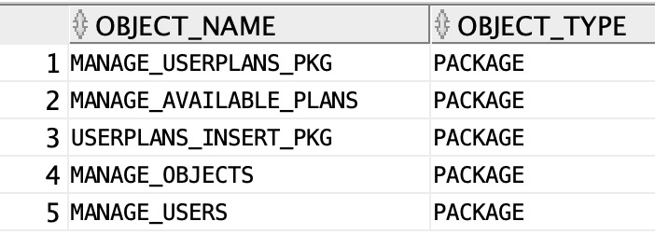
PACKAGES

Slide 20
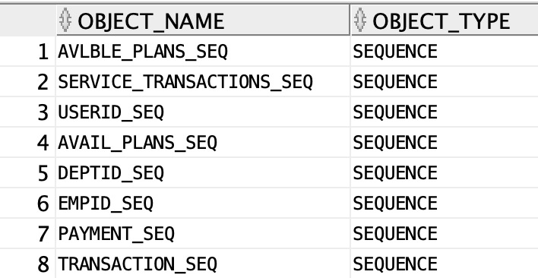
SEQUENCES

Slide 21
Team Contribution

Slide 22
Niharika Vittal
Table creation and inserting data
Triggers
Indexing
Procedures
Packages
ppt

Slide 23
Sruthi Bhaskar
Table creation and inserting data
Functions
Procedures
Views
Triggers

Slide 24
Soumya Rayappanor
Table creation and inserting data
Sequences
Procedures
Packages
Implementing Security

Slide 25
Thank You!

